Slide 1
An Agile Way As an SET At LINE
Hiroyuki Ito
Notes:
Thank you for your attentiion!
Today, I'd like to talk about SET activities based on Agile in LINE Corporation.

Slide 2

Objective
To explain
how to promote
your mission
with Agile
Notes:
The word “mission” includes “product planning”, “software development project”, and so on.

Slide 3
Another/Real Objective
To share
activities
in LINE Corp.

Slide 4
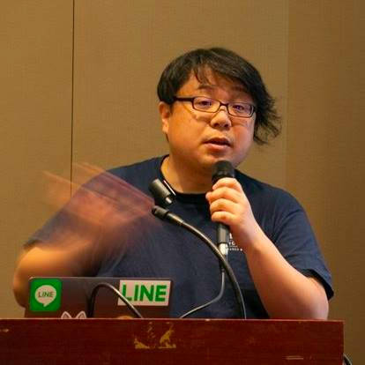


Hiroyuki Ito (The HIRO)
@hageyahhoo
The 1st SET at LINE Corp.
Keynote Speaker of DevOps Summit 2016 (TW)
Speaker of Agile2014
Notes:
Before starting the session, please introduce myself.
I made presentations at some global conferences.
Additionally, I am a Certified Scrum Professional.

Slide 5

Background
Notes:
Without further ado, let's move on to the Background of this session.

Slide 6

My Mission (2017/09-)
To found SET
and to lead
Test Automation
at LINE Corp.
Notes:
Quick show of hands. Who knows SET?

Slide 7

What is SET?
Software Engineer in Test
[Summary]
Test Automator
Tester and developer
Improve processes with (automated) test
From Wikipedia
Notes:
- From Google. - The same as ”Software Development Engineer in Test” (SDET) at Microsoft, Amazon, Apple, and so on.
- Google changed “SET” as “SETI” in 2016.
- Not QA who acts as the quality gate after development.
- Work with developers to enhance their productivity with automated test scripts.

Slide 8
Challenges
1. ? What should I do?
Confusion/disagreements about SET role
2. ? Details of products to test
I was a newbie at that time!
3. Wanted stakeholders’ supports widely
To lead new activities smoothly as a newbie
Notes:
When I joined LINE, I faced with 3 challenges.

Slide 9
Solutions
1. ? What should I do?
-> Discover needs
2. ? Details of products to test
-> Learn quickly from experiments
3. Wanted stakeholders’ supports widely
-> Deliver values quickly/periodically
Notes:
To come up with these challenges, I chose these solutions.

Slide 10
Agenda
1. Discover Needs
2. Learn Quickly from Experiments
3. Deliver Values Quickly/Periodically
4. What to Do Next
5. Conclusion

Slide 11
1. Discover Needs
2. Learn Quickly from Experiments
3. Deliver Values Quickly/Periodically
4. What to Do Next
5. Conclusion

Slide 12

First Challenge
Confusion/disagreements
about SET
among stakeholders
No shared understanding
No verbalized needs/problems
No leaders to solve them

Slide 13
Solutions
Share understanding by discovering and verbalizing needs
Establish proposals and solutions to solve above needs
Iterative consensus on above ones with managers/executive
Re-examine solutions constantly and iteratively

Slide 14



“3 KPIs” as Criteria
Sales
Profit
Employee
Satisfaction

Slide 15
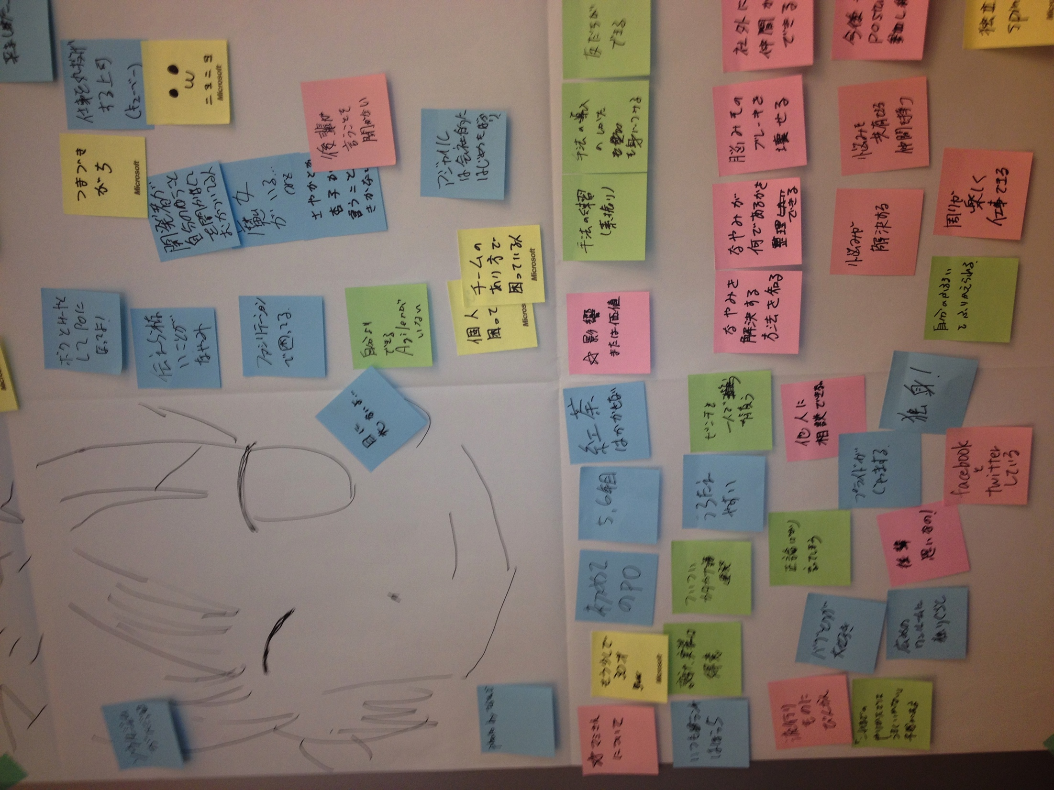
Agile Way
Product Discovery
Discovering and refining solutions
by iterative hypothesis and test cycle
Persona
User Interview
User Story Mapping
MVP
KPI

Slide 16
1. Discover/Verbalize Needs
Analyze target products to test
Analyze outage reports
Talk to stakeholders directly

Slide 17


1) Analyze Target Products
With Continuous Integration
and Static Code Analysis
Code coverage
The amount of technical debts
Priorities to improve

Slide 18
2) Analyze Outage Reports
Reports == Treasure-trove
We can know
problematic products
causes of outages
impact on sales and profit
how to reduce outage and MTTR

Slide 19
3) Talk to Stakeholders
Troubles == Src of Ideas
They may have non-verbalized troubles
Verbalizing their troubles will be the start of collaboration
Direct and honest conversation is good to know troubles deeply

Slide 20
2. Establish Solutions
Decide target products based on
frequency of outages
impact on sales and profit
Aim to make failure detection faster and reduce MTTR
Utilize Test Automation
Validate ideas by working with developers and QAs

Slide 21
3. Iterative Consensus
Propose ideas and get feedback weekly
Discover proper solutions gradually
Achieve a consensus on solutions step by step
Re-examine solutions constantly

Slide 22

Summary
Discover and verbalize needs
Share understanding based on 3 KPIs
Iterative consensus and re-examination on solutions with stakeholders

Slide 23
1. Discover Needs
2. Learn Quickly from Experiments
3. Deliver Values Quickly/Periodically
4. What to Do Next
5. Conclusion

Slide 24
Next Challenge
Discovered needs
(Why & What)
How should we achieve? (How)

Slide 25
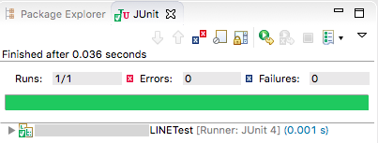
Solution
Learn target products by utilizing Test Automation
*Example

Slide 26
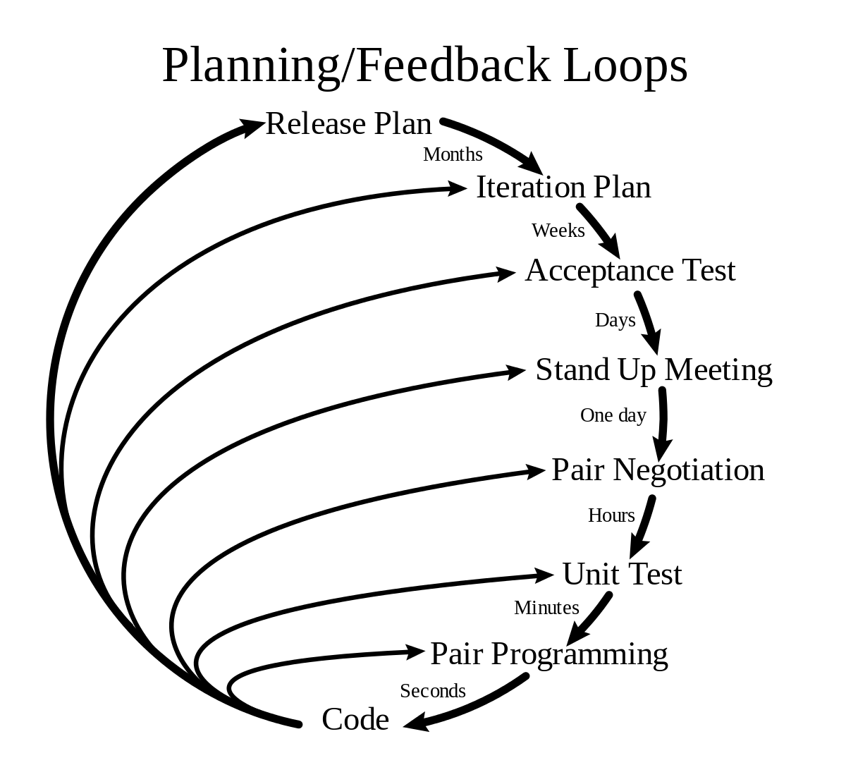
Agile Way
Extreme Programming (XP)
Built the mechanism to learn products very quickly

Slide 27
1. Run Products to Know
“Tests should help us
understand the SUT.”
from XUnit Test Patterns
Run test scripts where you want to know
Running products/features is a best way to learn
Current behavior is the truth

Slide 28
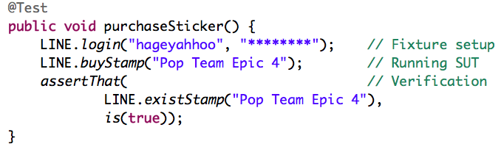
2. Easy to Run
xUnit tools are very common globally
and easy to understand
*Example

Slide 29
3. Good for Trial and Error
“Do Not Harm”
from XUnit Test Patterns
Test does not harm products if you write test scripts properly
You can fail a lot with safe
You can try a lot

Slide 30
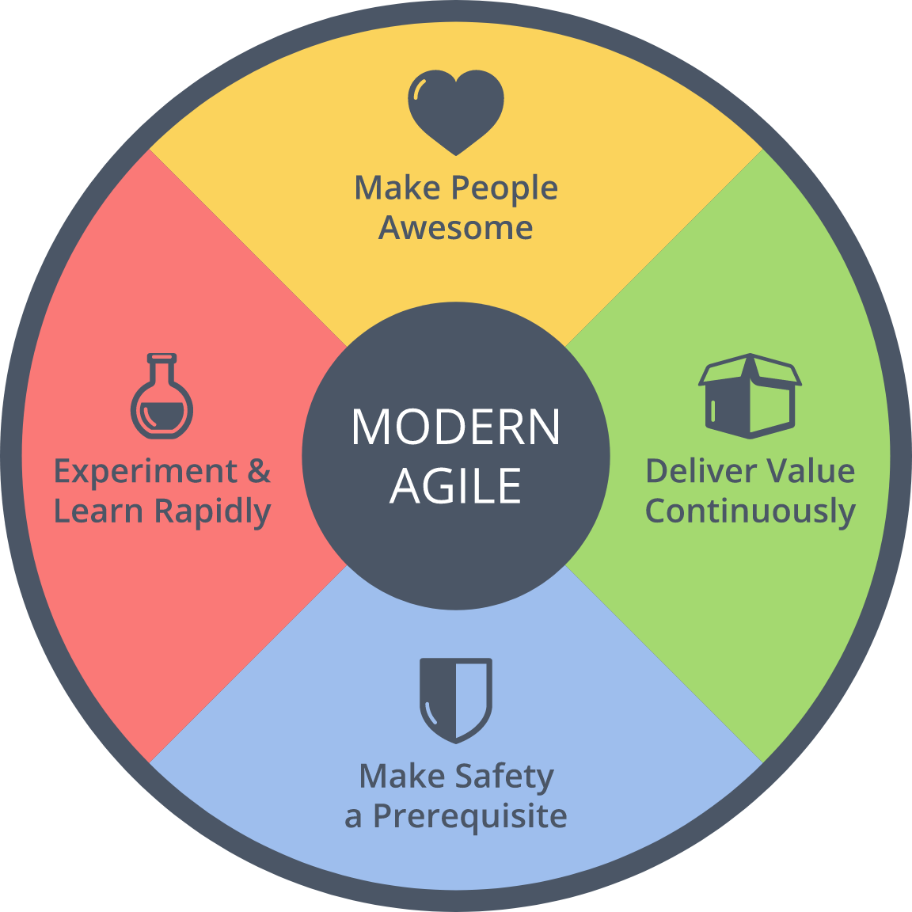
== Psychological Safety
From Modern Agile

Slide 31

Result
Achieved a consensus
on SET activities
with managers/executive
based on test scripts
within 45 days!

Slide 32
1. Discover Needs
2. Learn Quickly from Experiments
3. Deliver Values Quickly/Periodically
4. What to Do Next
5. Conclusion

Slide 33

Next Challenge
Wanted to collaborate with stakeholders widely

Slide 34



Solution
Deliver (executable) values weekly

Slide 35
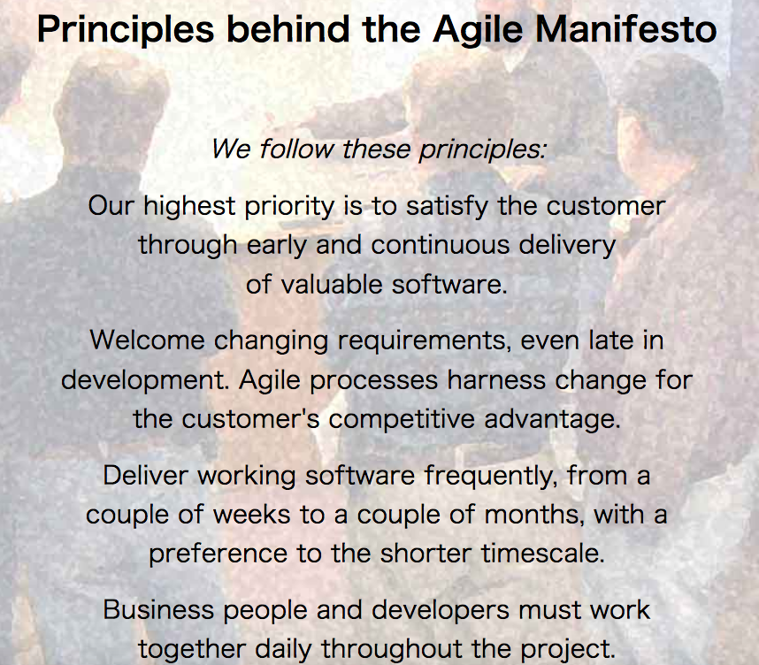
Agile Way
http://agilemanifesto.org/principles.html

Slide 36
Delivered Values (1)
1 week | Started writing test scripts to understand products
2 week | Proposed first idea of SET activities to managers/executive
3 week | Built mechanism to run and report static code analysis regularly
4 week | Shared to developers how to build static code analysis
5 week | Proposed milestones of activities to managers/executive

Slide 37
Delivered Values (2)
6 week | Agreed with proposals/milestones with managers/executive
7 week | Collected information and tools of QA/Tests in one place
8 week | Implemented failure detection for a problematic product
9 week | Guided to start regular meetings with developers and QAs
10 week | Started solving problems by developers step by step

Slide 38
Utilizing “3 KPIs”
Sales and Profit
All SET activities are aiming
to improve them
Employee Satisfaction
Managers/Executive
Discover/verbalize their anxieties
Provide quantitative information
Developers/QAs
Stimulate appetites for learning

Slide 39
Making Impacts Constantly
“Managing impact for a team of TEs and SETs is the job of the TEM.”
from How Google Tests Software

Slide 40
Results
Many persons started talking about SET
Managers/executive support SET activities positively
SET started collaborating with
Product development teams
QAs/Test Automators
Product Managers

Slide 41
1. Discover Needs
2. Learn Quickly from Experiments
3. Deliver Values Quickly/Periodically
4. What to Do Next
5. Conclusion

Slide 42
1. Create Slack Time
Many persons are reluctant to improve their work due to lack of slack time
Create slack time with automation technique
Provide hints for innovation

Slide 43
2. Find/Train Next SETs
There are few engineers
who have business perspective
and Test Automation skills
Find and train next SETs

Slide 44
3. Sum up Knowledge
Knowledge and experiences of SET are accumulating gradually
Sum up them as practices is good to proceed SET activities
Sum up them as patterns will be useful as common language

Slide 45
1. Discover Needs
2. Learn Quickly from Experiments
3. Deliver Values Quickly/Periodically
4. What to Do Next
5. Conclusion

Slide 46
Summary
To know your target is always the starting point
You need supporters widely to proceed actions
You can utilize Agile practices for above things

Slide 47
“3 KPIs” as Criteria
Sales
Profit
Employee
Satisfaction

Slide 48
My Mission (2017/09-)
To found SET
and to lead
Test Automation
at LINE Corp.

Slide 49

My Answer
Contribute to
our business
with
Test Automation!

Slide 50

Conclusion
Let’s
contribute to
the business
with Agile!

